Slide 1
Val Declarations
An assigning declaration

Slide 2
Variables
In SML, a variable is a language construct which can be associated a value and a type.
In books on programming languages, the terms variable, name, and identifier (id) are often used loosely in an interchangeable manner.
Conceptually, a variable represents a place where values can be stored.
An identifier is how the value in a place can be referenced within a program.

Slide 3
Syntax of Variables
Below is an oversimplified definition of SML identifiers.
alpha = [A-Za-z];
alphanumeric = [A-Za-z0-9_];
basic_id = {alpha}{alphanumeric}*;
wildcard = “_”;
identifier = {basic_id} | {wildcard};

Slide 4
Syntax
declaration ::= valDec
valDec ::= “val” matchPattern “=” expression
matchPattern ::= …

Slide 5
Val Declarations
Note that type information is not a required part of a val-declaration.
A val-declaration is like an “assigning declaration” – a “one time thing”. In other words, a declared variable is bound only once.
This is distinctly different from assignment where a variable can be bound and later re-bound.

Slide 6
Traditional usage
val x = 5 * 6;
val t = (x,7);
val (y,z) = t;
val m = (env,s);
val (env,s) = m;
Note that similar bindings and matches can occur between the formal parameters of a function declaration and the actual parameters of a function call.

Slide 7
Abstract view
The declaration
val matchPattern = expression
will result in the following match expression,
matchPattern << target
where target is the value that expression reduces to. Keep in mind that values, such as tuples, can have structure.

Slide 8
A term-language variation
Let us consider the following variation of our standard term language T(F,X) where tuples have arity-like functions, but have no name.
F⁰ = values belonging to primitive types
F² - tuples consisting of 2 elements
…
F^{n} - tuples consisting of n elements
X = SML identifiers (i.e., variables)

Slide 9
Note that
Primitive operations are not part of T(F,X).
In the future, we will add other terms to our term language (e.g., lists and user-defined datatypes).

Slide 10
Match patterns
A match pattern is a term belonging to T(F,X).
A match pattern may only contain nullary functions (i.e., constants) that belong to equality types.
A match pattern may contain extraneous parenthesis. These have no effect (they are stripped away in a preprocessing step).
Matching variables can only be bound to values. In other words, the ground terms in match expressions are values.
If the match of a val-declaration fails, an exception is thrown.

Slide 11
val-declaration | comment
val 0 = 0; | This is legal, but does nothing.
val (0) = 0; | This is legal, but does nothing.
val x = 0; | The variable x is bound to the value 0.
val (x) = 0; | The variable x is bound to the value 0.
val 0 = 1; | Match fails.

Slide 12
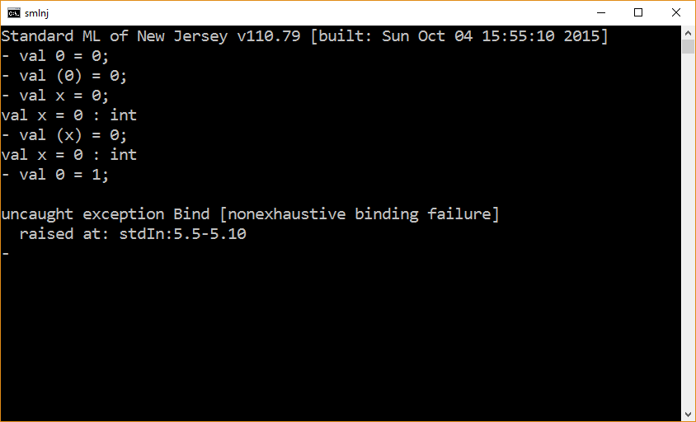

Slide 13
val-declaration | comment
val x = 1.0; | The variable x is bound to the value 1.0.
val x = 4 * 5; | The variable x is bound to the value 20.
val 1.0 = 1.0; | Illegal, 1.0 is of type real which is not an equality type.

Slide 14
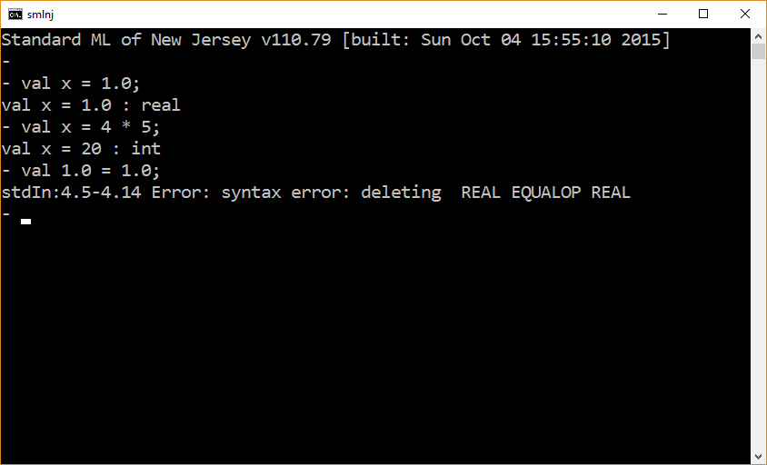

Slide 15
val-declaration | comment
val (x,y) = (1,2); | The variables x and y will be bound to the values 1 and 2 respectively.
val t = (1+2, 2*2); | The variable t is bound to the tuple (3,4).
val (x,y) = t; | Assuming the previous t, x and y will be bound to 3 and 4 respectively.
val (x,4) = t; | Assuming the previous t, x will be bound to 3.

Slide 16
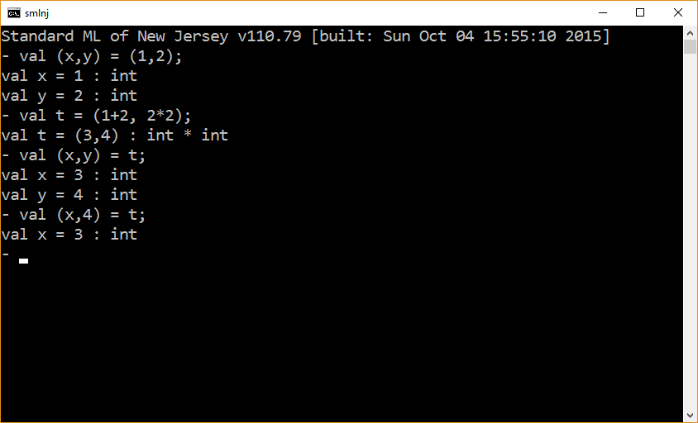

Slide 17
Linear use of variables
The matching algorithm presented in this course defines matching for terms which may contain multiple occurrences of the same (matching) variable.
plus(x,x) ≈ times(2,x)
Terms that prohibit multiple occurrences of the same matching variable are referred to as linear.
Terms that permit multiple occurrences of the same matching variable are referred to as non-linear.

Slide 18
Pattern Matching
SML uses a restricted form of matching called pattern matching.
Pattern matching only involves linear terms. This restriction is for efficiency purposes.
val-declaration | comment
val (x,y) = (1,1); | The variables x and y will be bound to the values 1 and 1 respectively.
val (x,x) = (1,1); | Error – nonlinear use of variables.

Slide 19
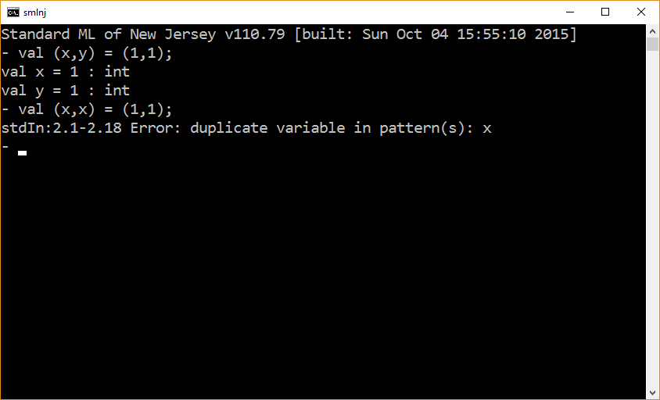

Slide 20
Wildcards
In SML, a token consisting of a single underscore denotes a kind of variable known as a wildcard.
Wildcards participate in pattern matching just like other variables.
However, wildcard bindings do not produce entries in the substitution σ that is created during matching. This is done for efficiency reasons.
Non-linear use of wildcards is match patterns is permitted.
A wildcard cannot occur on the rhs of an equation – an issue which we will encounter when we consider function declarations.

Slide 21
val-declaration | comment
val (x,_) = (1,2); | The variable x will be bound to the value 1.
val _ = print “\nhello\n”; | A “don’t care” val declaration used only for its side-effect.
val (_,y,_) = (1,2,3); | The variable y will be bound to the value 2.

Slide 22
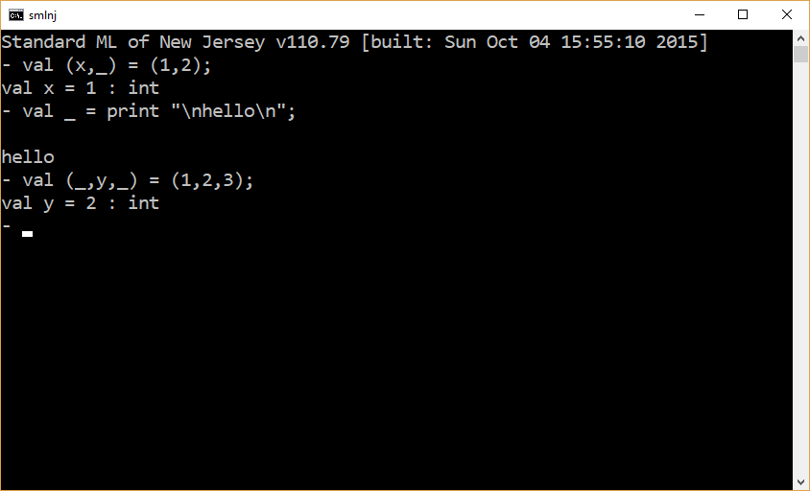

Slide 23
The end

